Slide 1
Power Plant Performance Dashboard

Slide 2
ACKNOWLEDGEMENT
On the very outset of this Presentation , I would like to extend my profound gratitude and indebtedness to Mr. Adit Agarwal , Founder of NoQS Digital, under whose constant support and guidance throughout this project , we can complete this project. His Inspiring intellectual guidance, constructive criticism and valuable suggestions helped us a lot.

Slide 3
CONTENT
Meet the team
Overview of the Dataset used
Key performance indicators
Energy Generation
Energy Distribution
No. of Power Plant Distribution
Top 5 States and Stations power generation
Energy Generation performance of different type of fuels
Working mechanism of Dashboard
Summary of the Insights
Conclusion
Q&A

Slide 4
Overview of the Dataset
Country
State LGD Code
State
Actual energy generated
Category of Plant
Type of fuel used
Installed Capacity
Region
Region ID
Sector of power plant
Name of coal company
Station Name
Source Month
Source Year
Year
Month
The dataset has different metrics for the energy generation of the power plants of India. Total no. of fields: 20
Total no. of Entries: 46676
Time Span: April 2008 - September 2016
The supply area is divided into 5 regions:
WESTERN
NORTHERN
EASTERN
SOUTHERN
NORTH EASTERN
Total No. of Stations: 580
Total No. of coal companies in the country: 209
Source: https://docs.google.com/spreadsheets/d/1ITsIF7yVAT8vouxAwtqMqt-qUoquxx5DwDtHXGNzTTM/edit?gid=0#gid=0

Slide 5
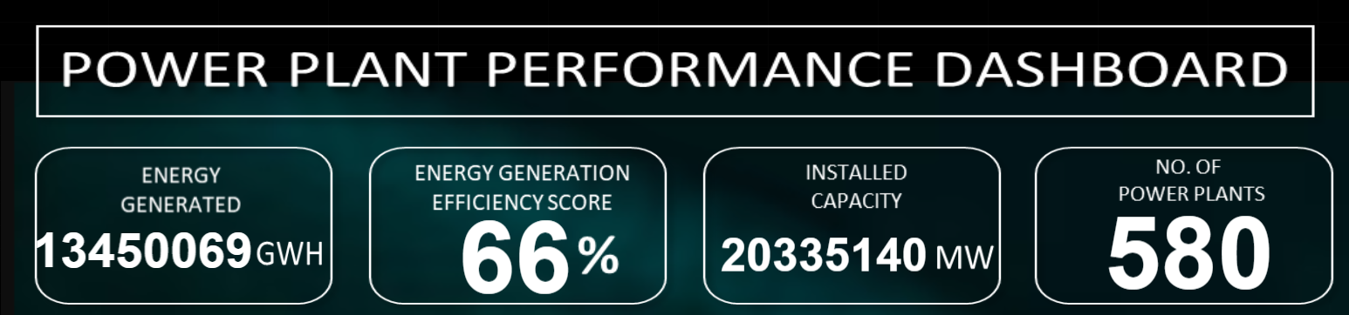
Key Performance Indicators
The Energy Generation Efficiency Score is a metric used to evaluate the efficiency of an energy generation system
Energy Generation Efficiency Score (%)= (Actual energy Generated /Installed Capacity )×100
Notes:
The Energy Generation Efficiency Score is a metric used to evaluate the efficiency of an energy generation system. It is typically calculated as the ratio of useful energy output to the total energy input, expressed as a percentage. This score helps in understanding how effectively an energy generation system converts input energy (such as fuel or sunlight) into useful output energy (like electricity or heat).

Slide 6
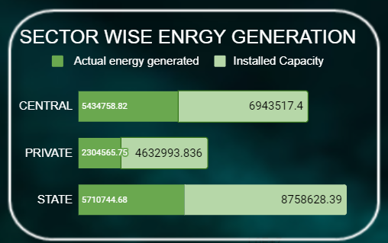
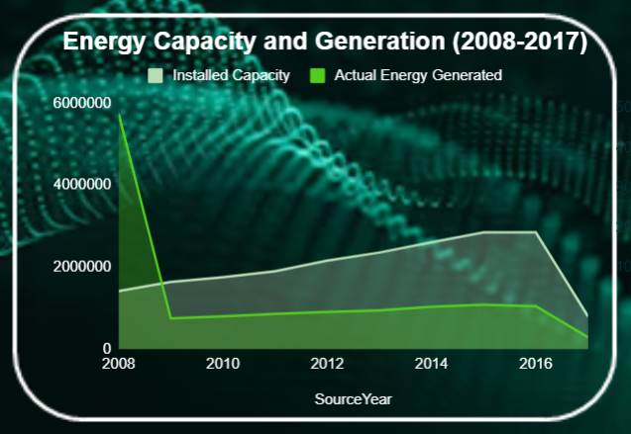
ENERGY GENERATION
Actual energy generated (GWH), Installed Capacity(MW)

Slide 7
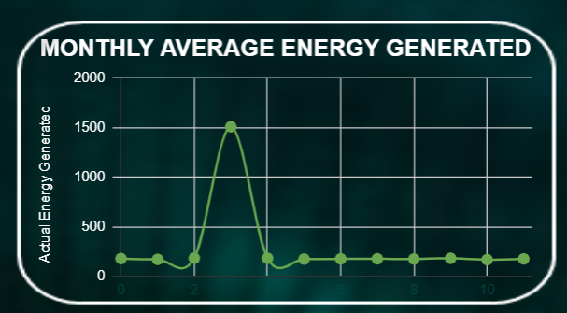
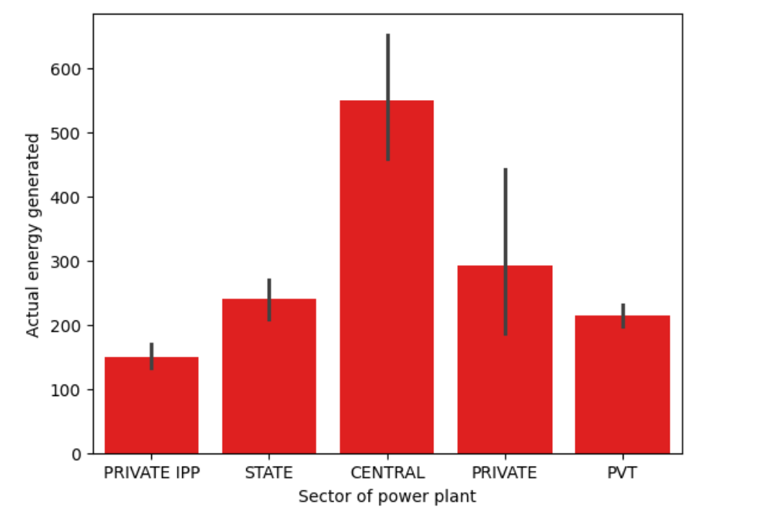
ENERGY GENERATION
The "CENTRAL" sector is the most significant contributor to actual energy generation.

Slide 8
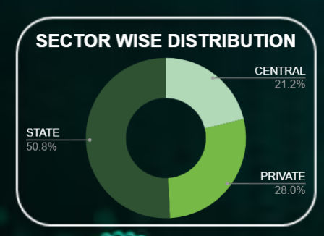
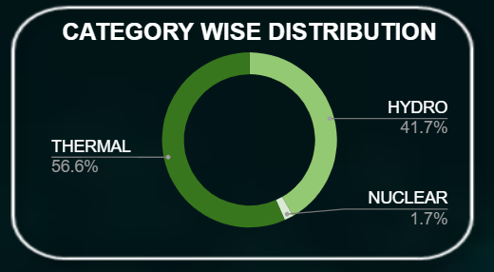
NO. OF POWER PLANT DISTRIBUTION

Slide 9
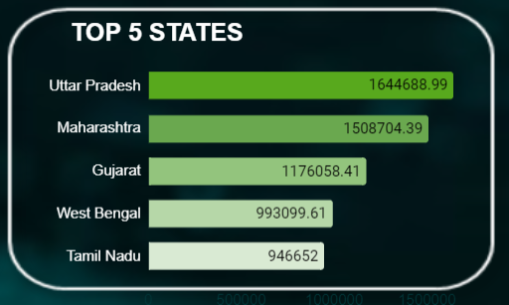
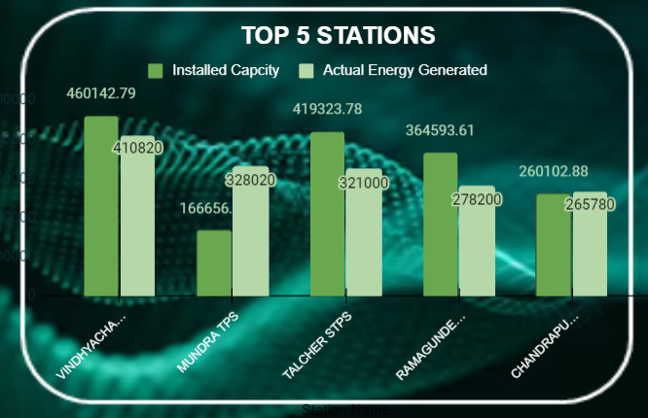
Top 5 States and Stations power generation
UTTAR PRADESH generate the highest amount of power in India.
VINDHYACHAL Thermal power generated highest amount of power in India.

Slide 10
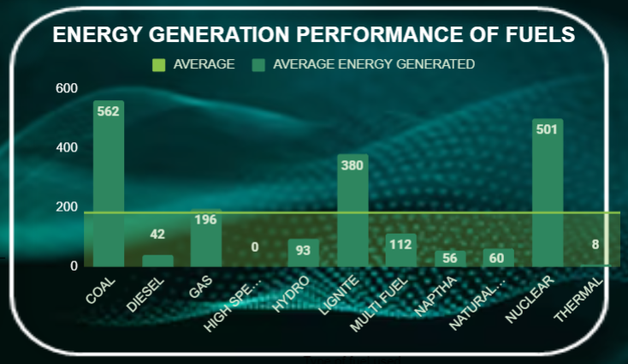
Energy Generation Performance of different types fuels
As we can see that from this graph ,The major source for energy generation COAL.

Slide 11
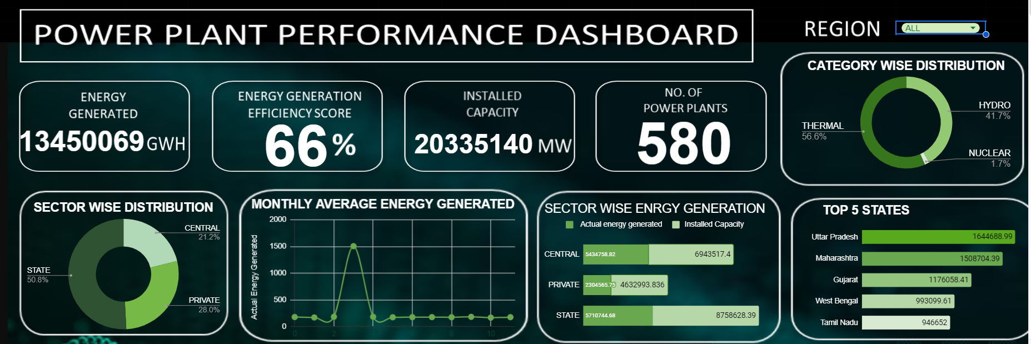
Dashboard working mechanism
Notes:
Step 1 if you click in region ( all ) it will show all energy generated and inst capacity / and all other things

Slide 12
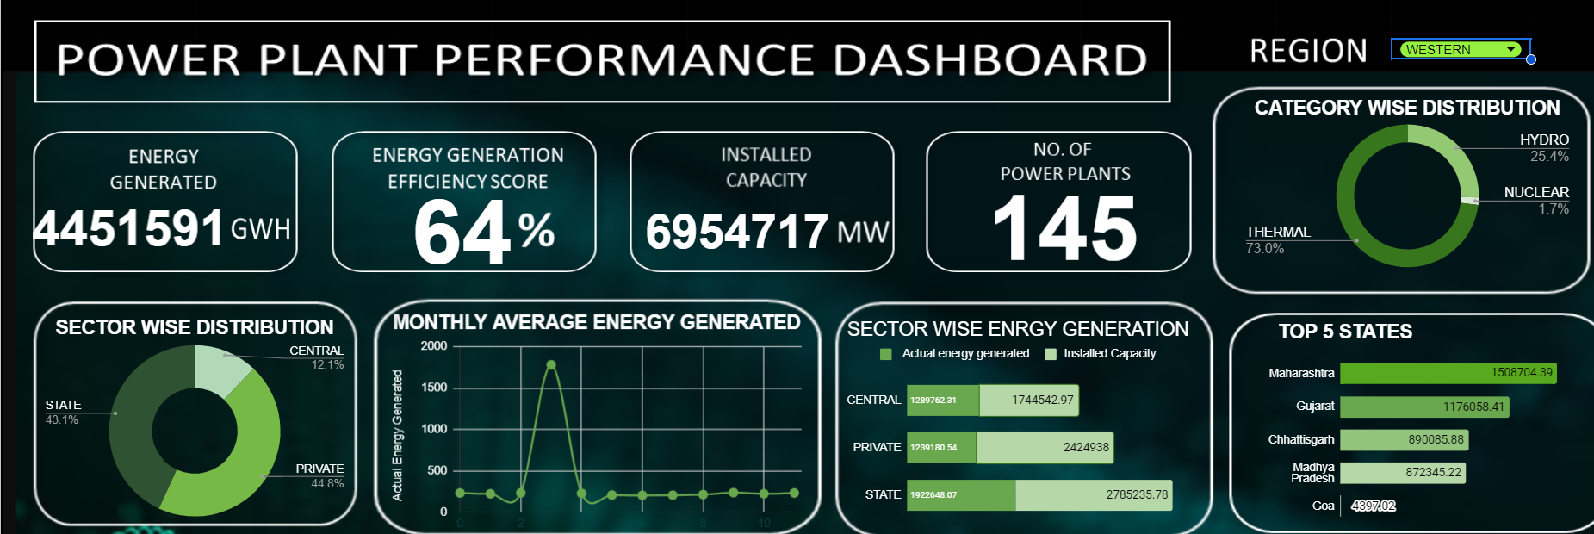
Dashboard working mechanism
Notes:
2nd step when you click in western all values got changed

Slide 13
CONCLUSION
1. Regional Performance:
Uttar Pradesh emerges as the leading state in terms of power generation.
Vindhyachal Thermal Power Station is identified as the highest power-generating station.
2. Energy Generation Sources:
The majority of energy generation comes from coal and nuclear plants.
The "Central" sector is the most significant contributor to actual energy generation.
3. Distribution Insights:
Approximately 51% of the power supply is sourced from state-owned facilities.
The data spans five regions (Western, Northern, Eastern, Southern, and North Eastern), with each region contributing to the overall energy supply

Slide 14
Future Scope
Expansion of Metrics: The dashboard could be expanded to include more detailed metrics related to energy generation and distribution, such as specific efficiency scores of different power plants.
Real-time Monitoring: Implementing real-time monitoring capabilities could provide instantaneous insights into energy generation and distribution patterns, enabling quicker decision-making.
Predictive Analytics: Integrating predictive analytics to forecast energy generation trends and potential distribution challenges could enhance the dashboard's utility for long-term planning.

Slide 15
Q&A
Thank you for your time!!

